Slide 1
Robot Subsystems and Simulators
21AIE213 - Robot Operating System and Robot Simulation

Slide 2
Previous Section
ROS Action
Turtlesim Action Service
Defining an Action
Example ROS Action
Implementing ROS Action Service
Creating a Action Server
Creating a Action Client

Slide 3
Section Overview
Robot Subsystems
Robot Simulators
Why Simulators
Common Simulators for Robotics
Common Features
Gazebo Simulator

Slide 4
Robot Subsystems
Three Major Subsystems
Actuation: In the ROS context, actuation subsystems are the subsystems that interact directly with how the robot’s wheels or arms move.
Sensing: Sensing subsystems interact directly with sensor hardware, such as cameras or laser scanners.
Computing: The computational subsystems are what tie actuators and sensing together, with (ideally) some relatively intelligent processing that allows the robot to perform useful tasks.

Slide 5
Actuation – Mobile Platform
The ability to move around, or locomote, is a fundamental capability of many robots.
A mobile base is a collection of actuators that allow a robot to move around. They come in an astonishingly wide variety of shapes and sizes.
Legged Locomotion vs Wheeled Locomotion
Platform complexity
Suited for smooth and even terrains

Slide 6
ACTUATION – MOBILE PLATFORM: Wheeled Mobile Robot
The simplest possible configuration of a wheeled mobile robot is called differential drive.
It consists of two independently actuated wheels, often located on the centerline of a round robot
Move Forward : Both Wheels turns forward
Spins : One wheel forward and another wheel backward
Differential-drive robots often have one or more casters
This is an example of a statically stable robot, which means that, when viewed from above, the center of mass of the robot is inside a polygon formed by the points of contact between the wheels and the ground.

Slide 7
ACTUATION – MOBILE PLATFORM: WHEELED MOBILE ROBOT
Dynamically stable or balancing wheeled mobile robots are also possible : Segway platforms, with a pair of large differential-drive wheels supporting a tall robot above
Four/Six Wheel Diffrential Drive : Left and Right actuation
More than six wheels Diffrential Drive : Tracked
Adavntage: Maximum traction
Disadvantage: Skidding !!!
Ackerman Steering
But cannot drive side ways
All these are Non-Holonomic systems, cannot move in all the direction at any given time

Slide 8
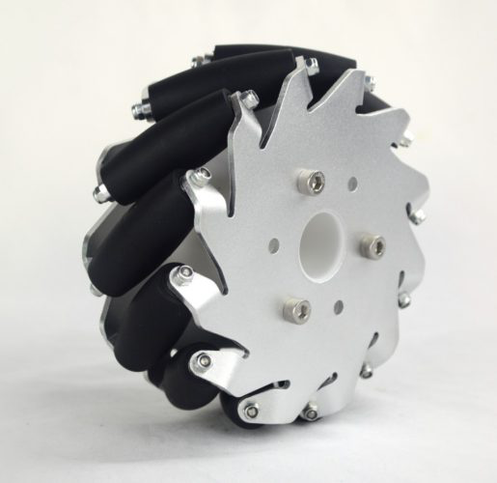
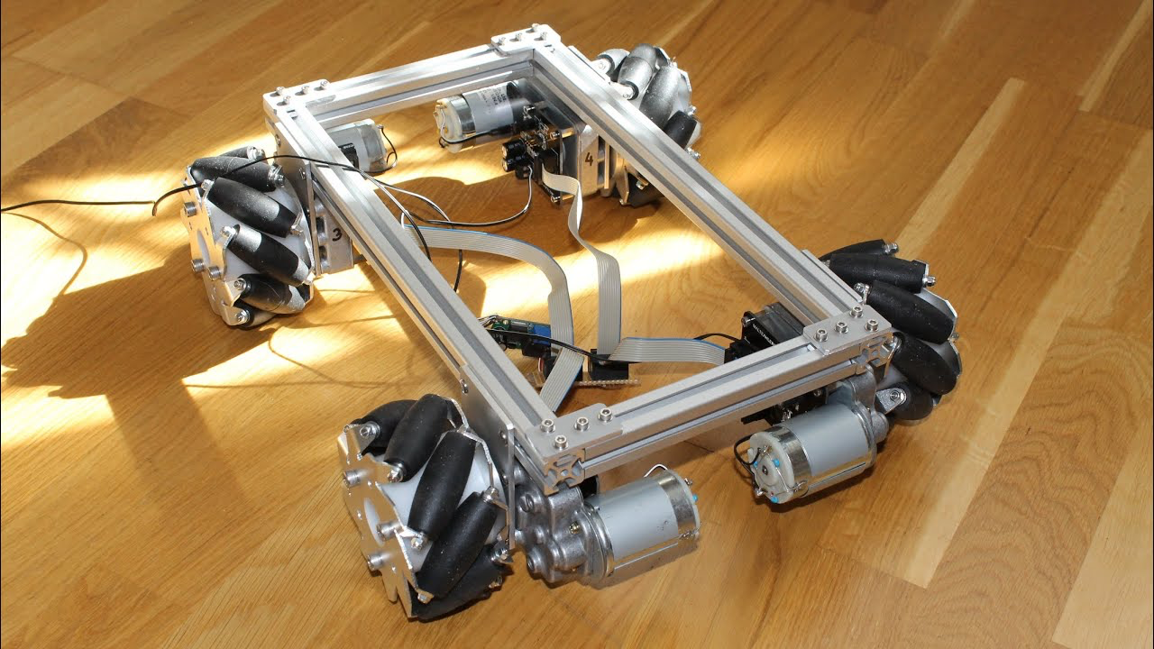
ACTUATION – MOBILE PLATFORM: WHEELED MOBILE ROBOT
Holonomic Platforms: Steered casters,each steered caster actuator has two motors: one motor rotates the wheel forward and backward, and another motor steers the wheel about its vertical axis.
Complex construction, but simple control
Low cost holonomic platform with Meccanum Wheels

Slide 9
ACTUATION – Manipulator ARM
As with mobile bases, there’s astonishing variety in manipulator-arm subsystems across robots, with many trade-offs made to support particular application domains and price points.
The majority of manipulator arms are formed by a chain of rigid links connected by joints
Joints – Revolute and Prismatic
A fundamental characteristic of a robot manipulator is the number of degrees of freedom (DOF) of its design
Often, the number of joints is equal to the number of actuators; when those numbers differ, typically the DOF is taken to be the lower of the two numbers.

Slide 10
ACTUATION
ROS software that interacts with mobile platforms virtually always uses a Twist message rather wheel velocities
A twist is a way to express general linear and angular velocities in three dimensions.
Used in planar and spatial robot

Slide 11
Sensing
Robots must sense the world around them in order to react to variations in tasks and environments.
The sensors can range from minimalist setups designed for quick installation to highly elaborate and tremendously expensive sensor rigs
Sensor Like
Limit Switch – Binary Sensor
Pressure/Sound/Light Sensor – Scalar Range Sensor
Each sensor class has its own quirks that distort its view of reality and must be accommodated by sensor-processing algorithms.
As a result of these quirks, it is often advantageous to combine several different types of sensors in a robotic system.

Slide 12
Sensing
It is common for robots to have a sensor head on top of the platform that integrates several sensors in the same physical enclosure.
Visual Cameras - sensor_msgs/Image uses cv_bridge package to connect OpenCV
Depth Cameras - sensor_msgs/PointCloud2
Laser Scanners - sensor_msgs/LaserScan
Shaft Encoders - geometry_msgs/Transform, sensor_msgs/JointState

Slide 13
Computation
Impressive robotic systems have been implemented on computing resources ranging from large racks of servers down to extremely small and efficient 8-bit microcontrollers
ROS takes a more traditional software-engineering approach to robotic computational architecture, ROS uses a dynamic message-passing graph to pass data between software nodes
This does not come for free. It certainly requires additional CPU cycles

Slide 14
Computation
Because of this messaging overhead and the emphasis on module isolation, ROS2 is not currently intended to run on extremely small microcontrollers
ROS2 currently must run on top of a full-featured operating system such as Linux/Mac OS X/Windows 10
ROS2 can run on smallform-factor embedded computer systems such as Gumstix, Raspberry Pi, or BeagleBone, among many others.
Going up the performance and power curve, ROS has been widely used on a large range of laptops, desktops, and servers.
Human-scale robots often carry one or more standard PC motherboards running Linux headless, which are accessed over a network link.

Slide 15
Simulators Defined
A simulation is an approximate imitation of the operation of a process or system; that represents its operation over time.
Wikepedia

Slide 16
Why Simulators ?
Implement and test your solution
faster
almost at no cost
Debugging is easy and fast
Parallelize development
Emphasis on the control algorithm
Makes real time deployment easier and faster

Slide 17
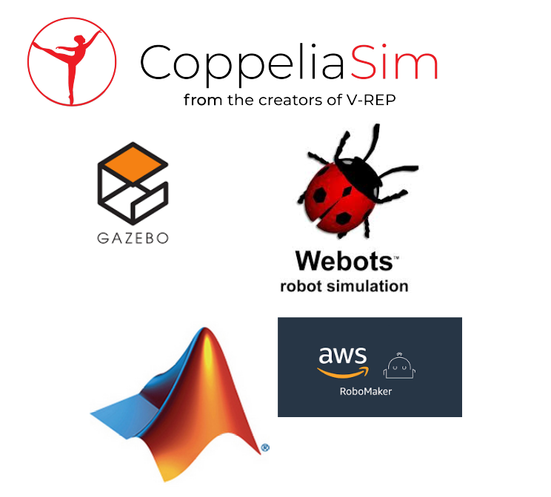
Available Simulators
Open Source Simulators
Player/Stage
Gazebo
V-Rep/CoppeliaSim
Webots
Others
Licensed Simulators
MATLAB
Microsoft - Robotic Developer Studio
Amazon - RoboMaker
Others

Slide 18
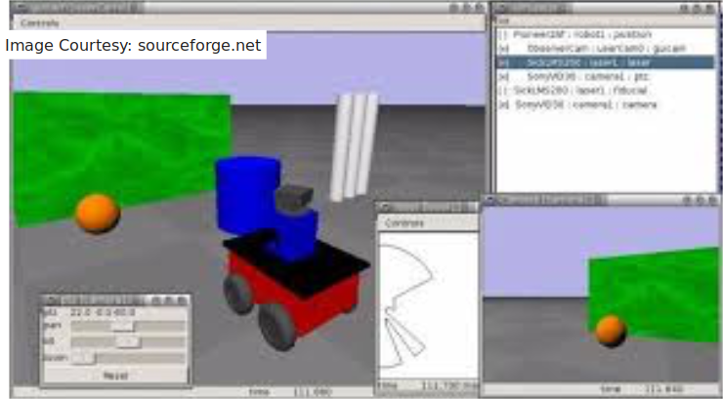
Common Features
Typical Simulator contains all the components of an IDE
3D window
Text Editor
Compiler/Debugger
Console
Flasher
Robot/Environment Design
World - Robot and its environment
Creating words using GUI/URDF
Robot Control Software
C, C++, Java, Python etc…

Slide 19
Gazebo
A well-designed simulator makes it possible to rapidly test algorithms, design robots, perform regression testing, and train AI system using realistic scenarios.
Gazebo offers the ability to accurately and efficiently simulate populations of robots in complex indoor and outdoor environments.
At your fingertips is a robust physics engine, high-quality graphics, and convenient programmatic and graphical interfaces.
Best of all, Gazebo is free with a vibrant community.
It is ROS inbuilt simulator

Slide 20
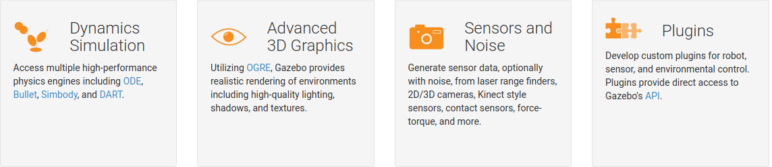
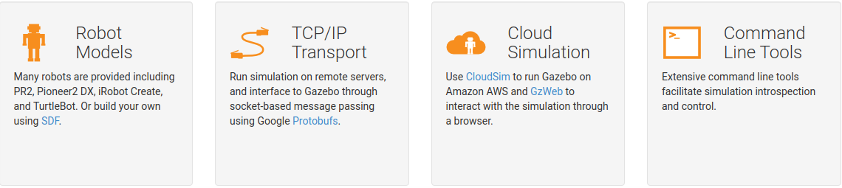
Gazebo Features

Slide 21
Thank You !!!

